Slide 1
Assessing the Low-Income Housing Tax Credit Using Machine Learning
David Grubman
General Assembly Data Science Spring 2017

Slide 2
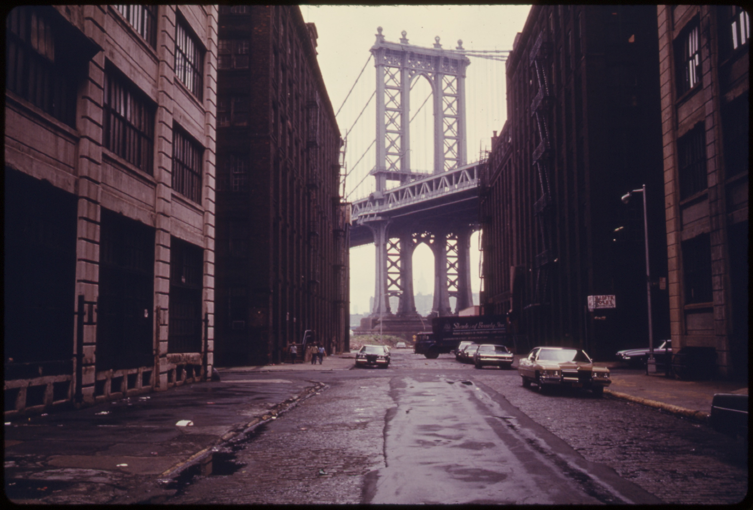
Background of the Low-Income Housing Tax Credit
Created in 1986 under President Reagan to further the development of affordable housing (Section 42 of the 1986 Tax Reform Act).
Tax credits are exchanged on an open marketplace.
The allocation of tax credits is handled through each state agency, meaning the state decides which projects will be afforded tax credits.
The program allows for the leverage of private equity in previously underserved areas

Slide 3
38,365
Low-Income Housing Tax Credit Properties placed in service since 1987

Slide 4
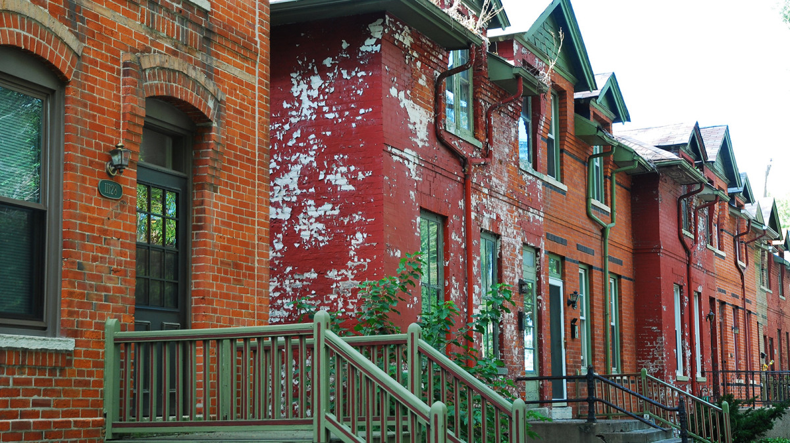
Criticisms of the Program
Too much power is concentrated at the state agency level
The developments are contributing to the concentration of poverty

Slide 5
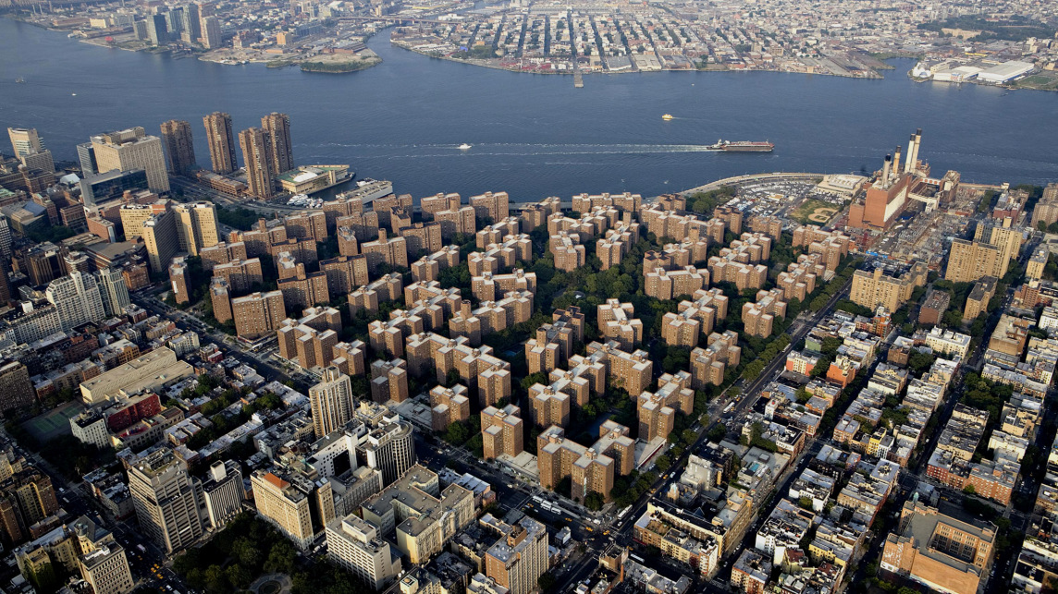
Question: Does a LIHTC project have a negative impact on the neighborhood in terms of income growth?
Use a linear regression to predict change in income for census tracts that contain LIHTC units.

Slide 6
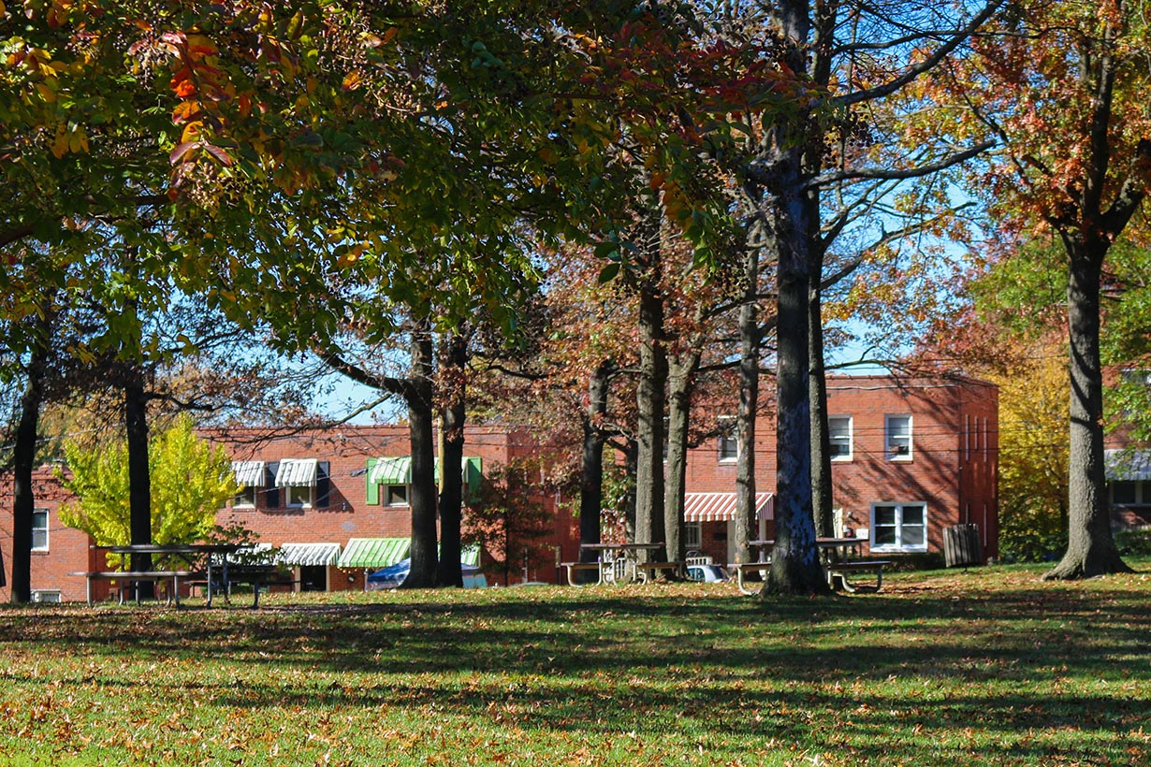
MACHINE LEARNING
Determine if the program is, in fact, determining the neighborhood

Slide 7
Process
Mine, clean, and parse data from Housing and Urban Development
second
last

Slide 8

HELLO!
I am Jayden Smith
I am here because I love to give presentations.
You can find me at @username

Slide 9
HELLO!
I am Jayden Smith
I am here because I love to give presentations.
You can find me at @username

Slide 10
1.
TRANSITION HEADLINE
Let’s start with the first set of slides

Slide 11
Quotations are commonly printed as a means of inspiration and to invoke philosophical thoughts from the reader.

Slide 12
THIS IS A SLIDE TITLE
Here you have a list of items
And some text
But remember not to overload your slides with content
Your audience will listen to you or read the content, but won’t do both.

Slide 13
YOU CAN ALSO SPLIT YOUR CONTENT
White
Is the color of milk and fresh snow, the color produced by the combination of all the colors of the visible spectrum.
Black
Is the color of coal, ebony, and of outer space. It is the darkest color, the result of the absence of or complete absorption of light.

Slide 14
IN TWO OR THREE COLUMNS
Yellow
Is the color of gold, butter and ripe lemons. In the spectrum of visible light, yellow is found between green and orange.
Blue
Is the colour of the clear sky and the deep sea. It is located between violet and green on the optical spectrum.
Red
Is the color of blood, and because of this it has historically been associated with sacrifice, danger and courage.

Slide 15
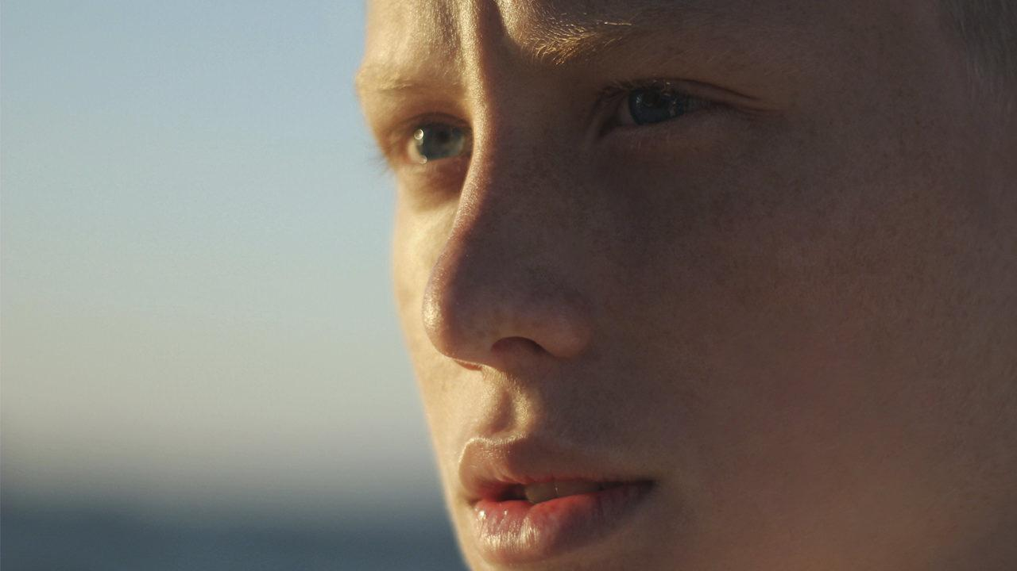
A PICTURE IS WORTH A THOUSAND WORDS
A complex idea can be conveyed with just a single still image, namely making it possible to absorb large amounts of data quickly.

Slide 16

WANT BIG IMPACT?
USE BIG IMAGE

Slide 17
USE CHARTS TO EXPLAIN YOUR IDEAS
White
Black
Gray

Slide 18
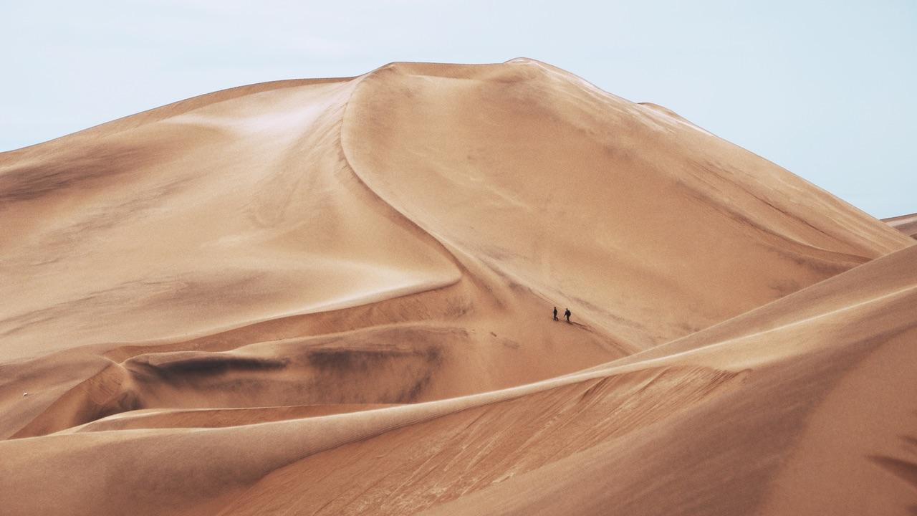
AND TABLES TO COMPARE DATA
 | A | B | C
Yellow | 10 | 20 | 7
Blue | 30 | 15 | 10
Orange | 5 | 24 | 16

Slide 19

MAPS
our office

Slide 20
89,526,124$
185,244 users
100%
That’s a lot of money
And a lot of users
Total success!

Slide 21

LET’S REVIEW SOME CONCEPTS
Yellow
Is the color of gold, butter and ripe lemons. In the spectrum of visible light, yellow is found between green and orange.
Blue
Is the colour of the clear sky and the deep sea. It is located between violet and green on the optical spectrum.
Red
Is the color of blood, and because of this it has historically been associated with sacrifice, danger and courage.
Yellow
Is the color of gold, butter and ripe lemons. In the spectrum of visible light, yellow is found between green and orange.
Blue
Is the colour of the clear sky and the deep sea. It is located between violet and green on the optical spectrum.
Red
Is the color of blood, and because of this it has historically been associated with sacrifice, danger and courage.

Slide 22
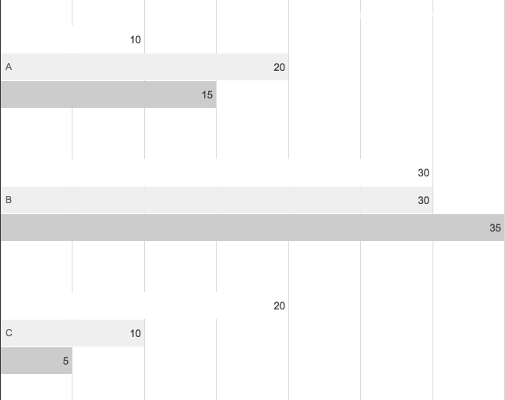
You can insert graphs from Google Sheets

Slide 23

ANDROID
PROJECT
Place your screenshot here
Show and explain your web, app or software projects using these gadget templates.

Slide 24
iPHONE
PROJECT
Place your screenshot here
Show and explain your web, app or software projects using these gadget templates.

Slide 25
TABLET
PROJECT
Place your screenshot here
Show and explain your web, app or software projects using these gadget templates.

Slide 26
DESKTOP
PROJECT
Place your screenshot here
Show and explain your web, app or software projects using these gadget templates.

Slide 27
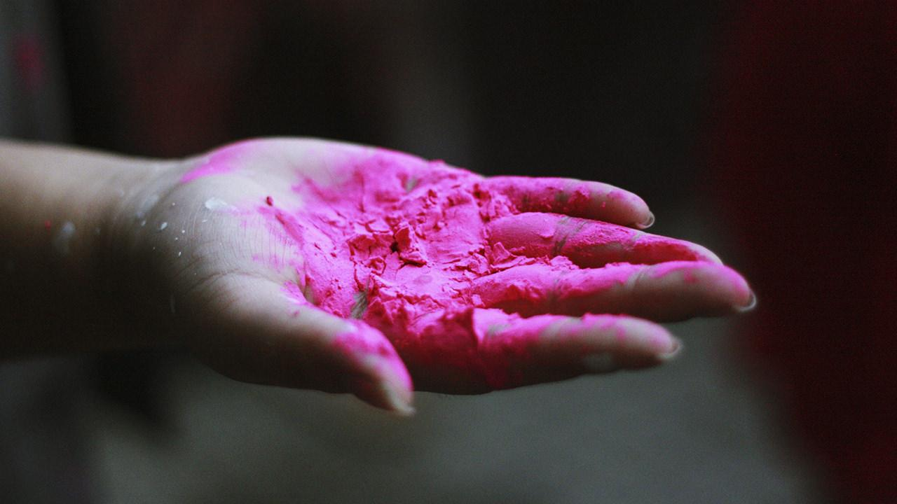
THANKS!
Any questions?
You can find me at
@username
user@mail.me

Slide 28

CREDITS
Special thanks to all the people who made and released these awesome resources for free:
Presentation template by SlidesCarnival
Photographs by Unsplash

Slide 29
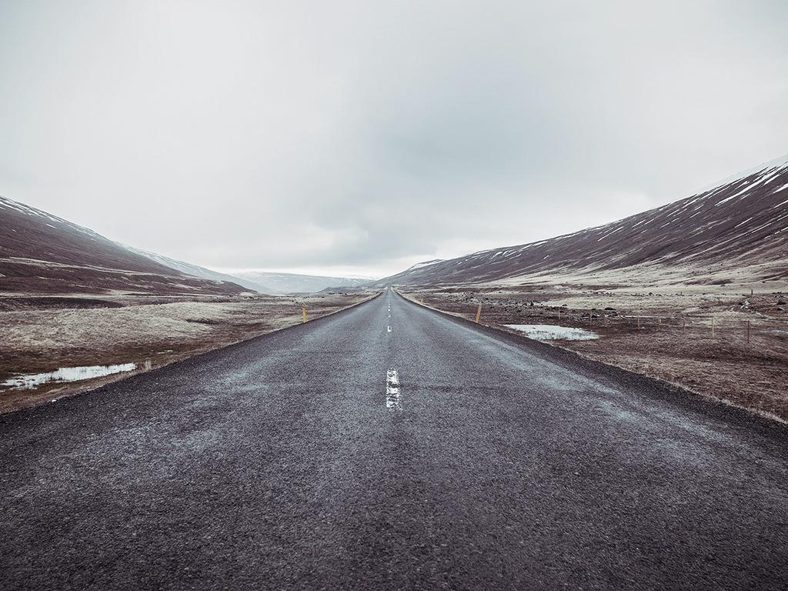
PRESENTATION DESIGN
This presentation uses the following typographies:
Titles: Raleway
Body copy: Varela
You can download the fonts on these pages:
https://www.fontsquirrel.com/fonts/raleway
https://www.fontsquirrel.com/fonts/varela
You don’t need to keep this slide in your presentation. It’s only here to serve you as a design guide if you need to create new slides or download the fonts to edit the presentation in PowerPoint®

Slide 30

SlidesCarnival icons are editable shapes.
This means that you can:
Resize them without losing quality.
Change line color, width and style.
Isn’t that nice? :)
Examples:

Slide 31
😉
Now you can use any emoji as an icon!
And of course it resizes without losing quality and you can change the color.
How? Follow Google instructions https://twitter.com/googledocs/status/730087240156643328
✋👆👉👍👤👦👧👨👩👪💃🏃💑❤😂😉😋😒😭👶😸🐟🍒🍔💣📌📖🔨🎃🎈🎨🏈🏰🌏🔌🔑 and many more...

